Slide 1
Retrofit Library
for making network requests

Slide 2
Topics Covered
Overview of Retrofit
Benefits of Retrofit
Defining an API interface
Creating Retrofit instance
Converter Factory
Making a network request
Asynchronous call using enqueue()

Slide 3
Introduction
Retrofit is a type-safe HTTP client for Android and Java.
It's used to handle REST API interactions in a structured, efficient, and reliable manner.
It is highly configurable and extendable, allowing you to easily and safely communicate with a remote web server.
Under the hood, Retrofit’s implementation uses OkHttp, another library by Square, to handle making an HTTP request and parsing the HTTP response.

Slide 4
Benefits
Simplicity: Retrofit abstracts much of the boilerplate code involved in making network requests, allowing you to focus on the core logic.
Type Safety: Ensures that you are working with the correct types, reducing runtime errors.
Asynchronous: Supports asynchronous operations out of the box, making it easier to handle network operations without blocking the main thread.
Flexible and Extensible: Easily integrates with other libraries like Gson or Moshi for JSON parsing, and OkHttp for advanced networking capabilities.
Error Handling: Provides a structured way to handle various types of network errors.

Slide 5

Adding dependencies and permission
To use Retrofit you have to add the following dependencies.
Also, you need a library to map/convert JSON data to Java objects automatically, we will be using GSON for this.(there are others as well)
You will also need network permission to make the request.

Slide 6
Defining an API interface
Use an interface to define the API endpoints.
Similar to using the Room database library, you write an interface with annotated instance methods, and Retrofit creates the implementation.
The Retrofit annotations are used to describe the HTTP method and endpoint URL. (you can find out more about Retrofit annotations on https://square.github.io/retrofit/2.x/retrofit/ )

Slide 7
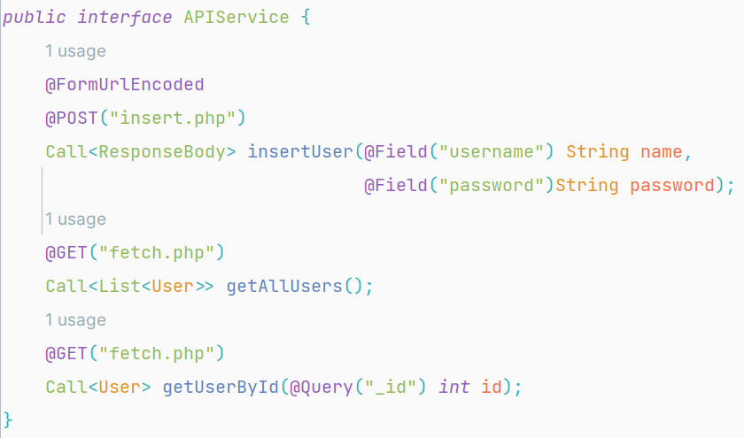
Cont.

Slide 8
Creating Retrofit instance
To create an instance of Retrofit, first you have to use Retrofit.Builder() to configure the base URL, converters, and other settings.
Make sure to include the appropriate protocol with the URL (here, https://).
And replace the URL with your actual IP and folder.
Also, always include a trailing / to ensure Retrofit correctly appends the relative paths you provide in your API interface onto the base URL.
Calling build() returns a Retrofit instance, configured based on the settings you specified using the builder object.
Once you have a Retrofit object, you use it to create an instance of your API interface.

Slide 9
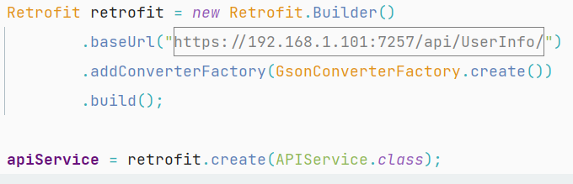
Cont.
When you call retrofit.create(), Retrofit uses the information in the API interface you specify, along with the information you specified when building the Retrofit instance, to create and instantiate an anonymous class that implements the interface on the fly(at runtime).

Slide 10
Converter Factory
When getting a response back from the server, by default, Retrofit deserializes web responses into okhttp3.ResponseBody objects.
But for logging the contents of a web page, it is much easier to work with a JSON
To get Retrofit to deserialize the response into JSON instead, you will specify a converter when building your Retrofit object.
A converter factory knows how to decode a ResponseBody object into some other object type.
Retrofit.Builder’s addConverterFactory(…) function expects an instance of Converter.Factory.

Slide 11
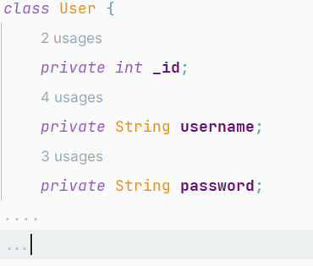
Cont.
We are going to use the GsonConverterFactory, which is going to map the JSON data to the User class defined below.

Slide 12
Making a network request
A Network request can be executed synchronously or asynchronously.
Use the methods defined in the Retrofit interface to execute API requests asynchronously or synchronously.
You can enqueue requests to execute them asynchronously and receive the results in a callback, or you can execute them synchronously using the execute() method.
Since synchronous network request blocks the UI(because it runs on the main thread) it is better to use asynchronous call.
To make asynchronous network request use enqueue() method.

Slide 13
Cont.
enqueue(): used to asynchronously execute an HTTP request.
It enqueues the request to be executed in the background, and once the request is completed, either onResponse or onFailure callback methods are invoked based on the result.
It takes one parameter that represents the callback interface that will handle the response or failure of the HTTP request.
onResponse and onFailure are callback methods provided by Retrofit's Callback interface, used to handle the response of an asynchronous HTTP request.

Slide 14
Cont.
Both methods have ‘Call<T> call’ parameter that represents the original call object that initiated the request.
onResponse(): invoked when the HTTP request is successful and a response is received from the server.
Use this method to handle successful responses, parse the response body, and update the UI or perform any necessary business logic based on the response.
In addition to ‘Call<T> call’, it has ‘Response<T> response’ parameter that represents the response received from the server. It contains information such as HTTP status code, headers, and the deserialized response body.

Slide 15
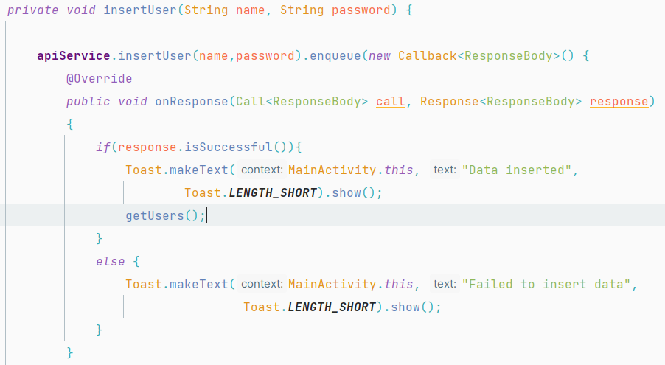
Cont.

Slide 16
Cont.
onFailure(): invoked when the HTTP request fails due to network errors, server errors, or any other exceptions.
Use this method to handle various types of failures that can occur during an HTTP request, such as network errors, timeouts, or server errors.
In addition to ‘Call<T> call’, it has ‘Throwable t’ that represents the error that occurred during the HTTP request. It could be a network-related error, server error, or any other exception.

Slide 17
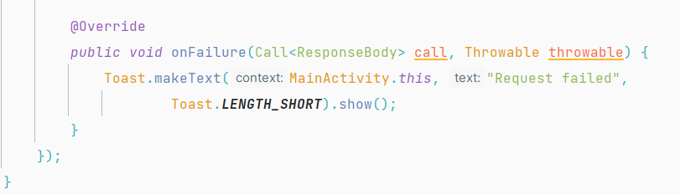
Cont.

Slide 18
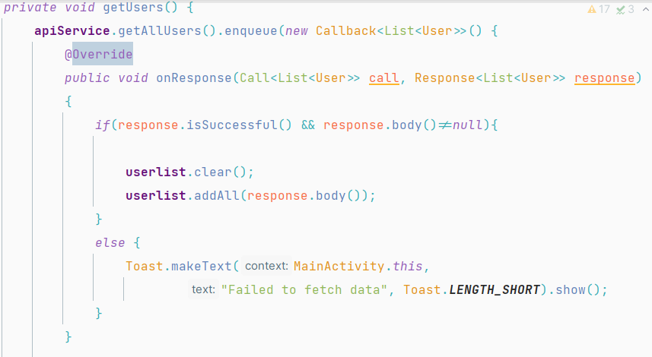
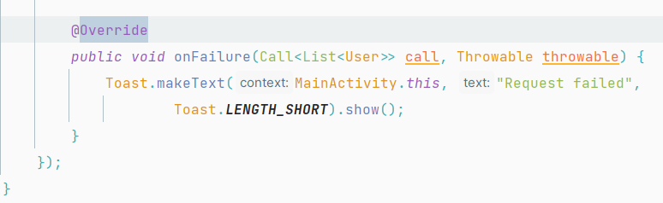
Cont.
Getting all users from a database through an API

Slide 19
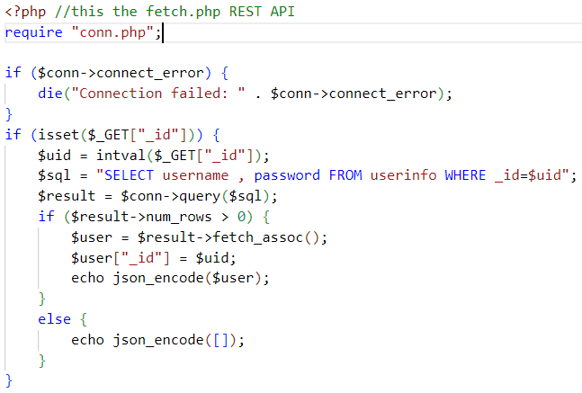
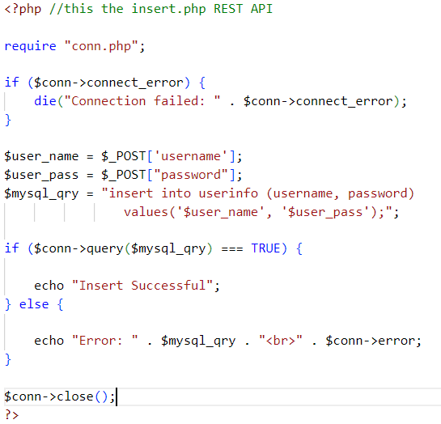
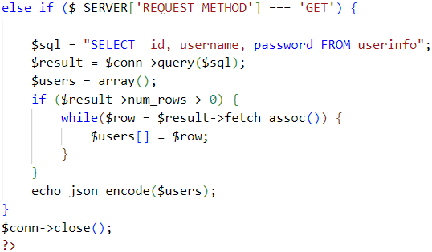
Appendix: Creating the REST API using PHP

Slide 20
Thank you

